Slide 1
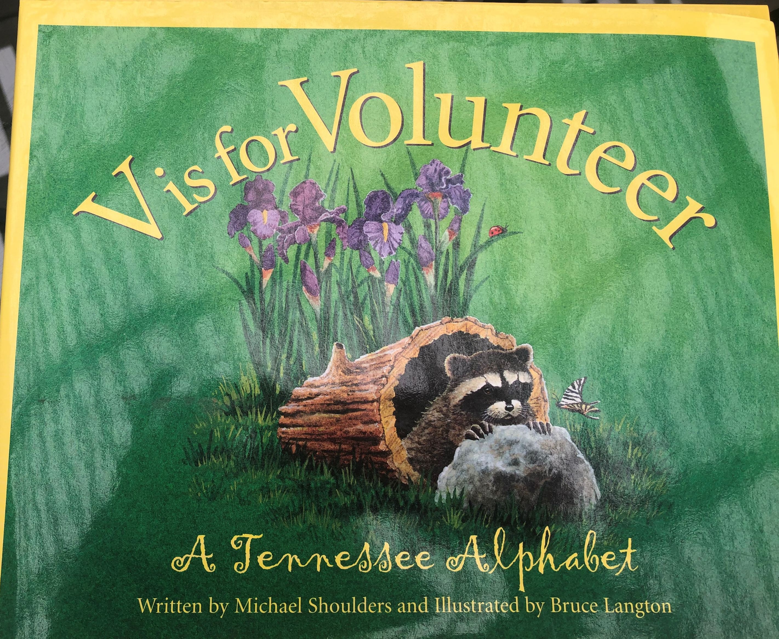

Slide 4
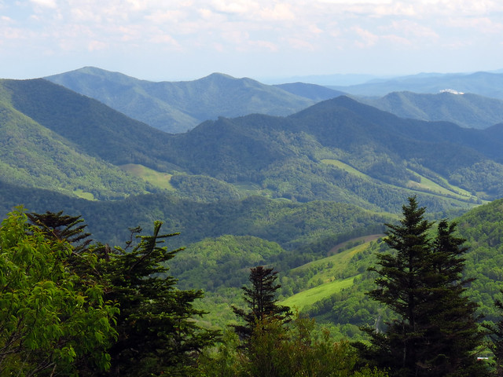
Appalachian Mountains
This Photo by Unknown Author is licensed under CC BY-SA
This Photo by Unknown Author is licensed under CC BY-SA-NC

Slide 5
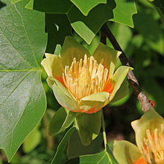
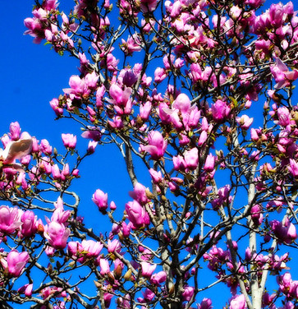
Tulip Poplar
This Photo by Unknown Author is licensed under CC BY-SA
This Photo by Unknown Author is licensed under CC BY-NC-ND
This Photo by Unknown Author is licensed under CC BY-NC-ND

Slide 6
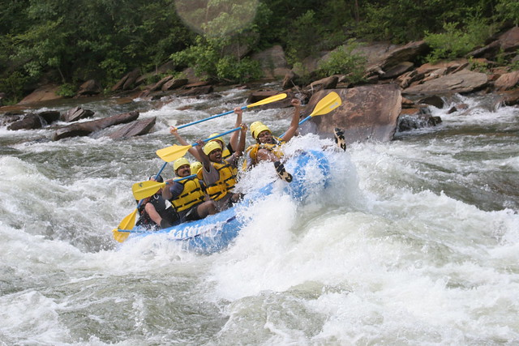
Ocoee River
This Photo by Unknown Author is licensed under CC BY-NC
This Photo by Unknown Author is licensed under CC BY-SA

Slide 8
Beale Street and the Blues Music
This Photo by Unknown Author is licensed under CC BY-SA
This Photo by Unknown Author is licensed under CC BY-SA

Slide 10
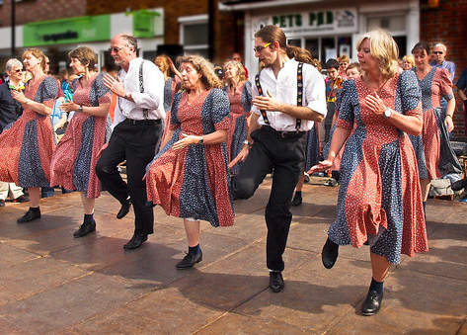
Clogging
This Photo by Unknown Author is licensed under CC BY-NC-ND
This Photo by Unknown Author is licensed under CC BY-SA

Slide 13
Daffodils
This Photo by Unknown Author is licensed under CC BY-SA-NC

Slide 14
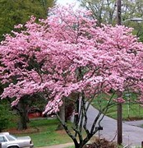
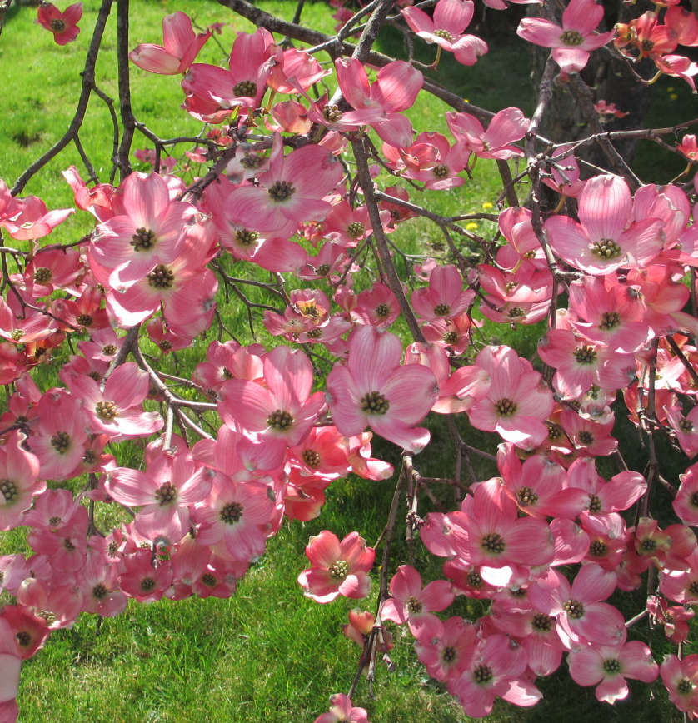
Dogwood Tree
This Photo by Unknown Author is licensed under CC BY
This Photo by Unknown Author is licensed under CC BY-NC-ND
This Photo by Unknown Author is licensed under CC BY

Slide 16
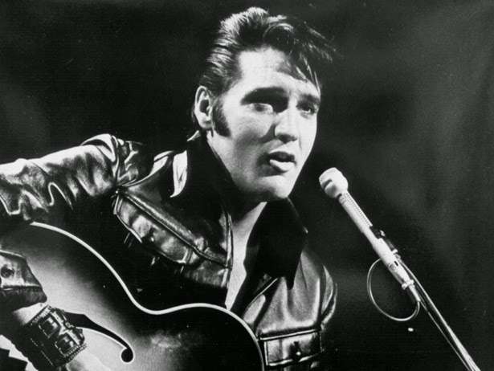
Elvis Presley
This Photo by Unknown Author is licensed under CC BY-NC-ND
This Photo by Unknown Author is licensed under CC BY-SA-NC

Slide 17
Graceland
This Photo by Unknown Author is licensed under CC BY-SA

Slide 19
Tennessee State Flag
This Photo by Unknown Author is licensed under CC BY-SA

Slide 20
Work Cited
Shoulders, Michael, and Bruce Langton. V Is for Volunteer: a Tennessee Alphabet. Thomson/Gale, 2004.

